Slide 1

The Process Concept
PASS
CS532: OS Foundations
Lab Assignment
Email: chitram2@pdx.edu

Slide 2
Instructions: Make a copy of this document, move your copy to your submissions folder and fill the document with your responses. Use the space on each slide to show your responses, and add additional slides as needed.
When ready for grading: complete the lab assignment submission form and include a link to your filled document

Slide 3
Get the OSTEP Simulators
For this lab assignment and several subsequent assignments you will utilize simulators provided by the authors of the OSTEP book. These simulators allow you to study infinite OS scenarios without the tedious, time-consuming work of configuring and measuring real operating systems.
To obtain all of the simulators, login to linux.cs.pdx.edu and clone the corresponding git repository. Do it like this:
git clone https://github.com/remzi-arpacidusseau/ostep-homework/

Slide 4
process-run.py
The process-run.py simulator helps us to understand process scheduling scenarios. To use it, cd into your new ostep-homework directory and then cd into the cpu-intro sub-directory. Read the Readme.md file contained in the cpu-intro directory. Read this file thoroughly and try every step shown there. Going through the Readme.md file thoroughly will give you a strong understanding of not only this simulator but also many of the simulators used for other lab assignments in this class.

Slide 5
1. Run process-run.py with the following flags: -l 5:100,5:100.
What should the CPU utilization be (e.g., the percent of time the CPU is in use?)
Explain your reasoning.

Slide 6
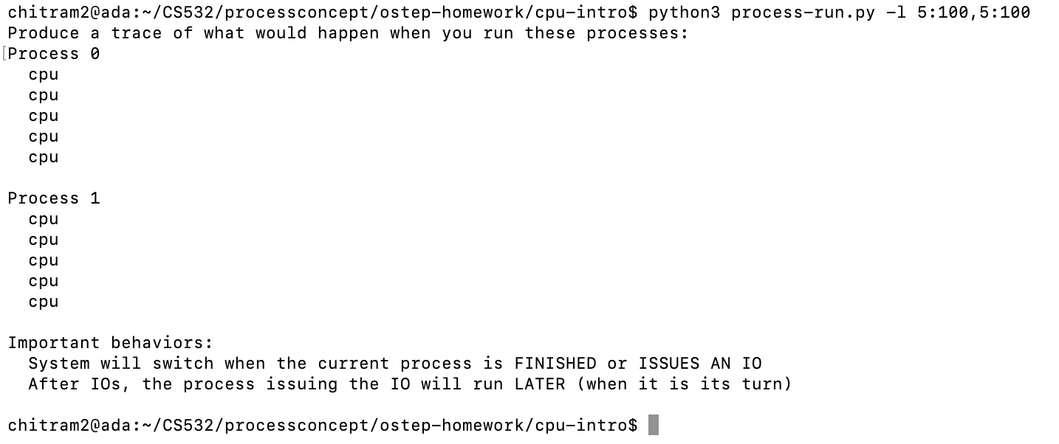

Slide 7
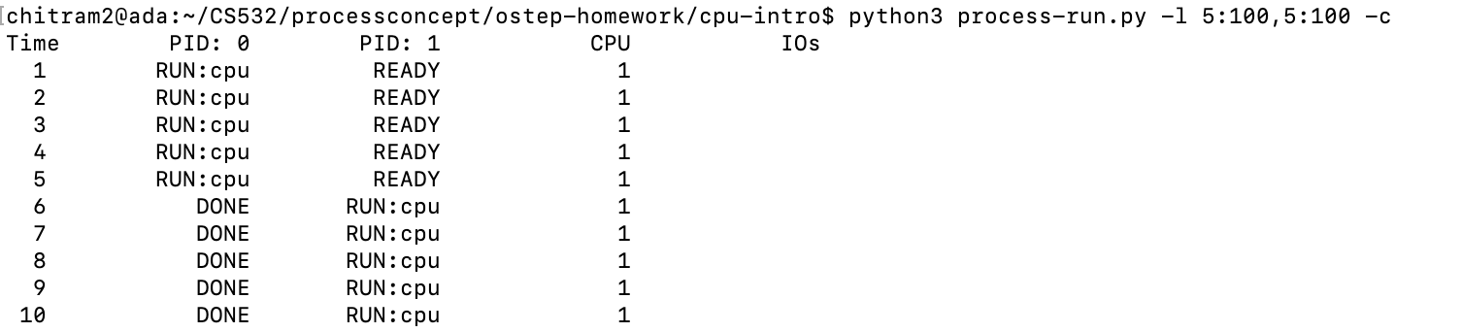
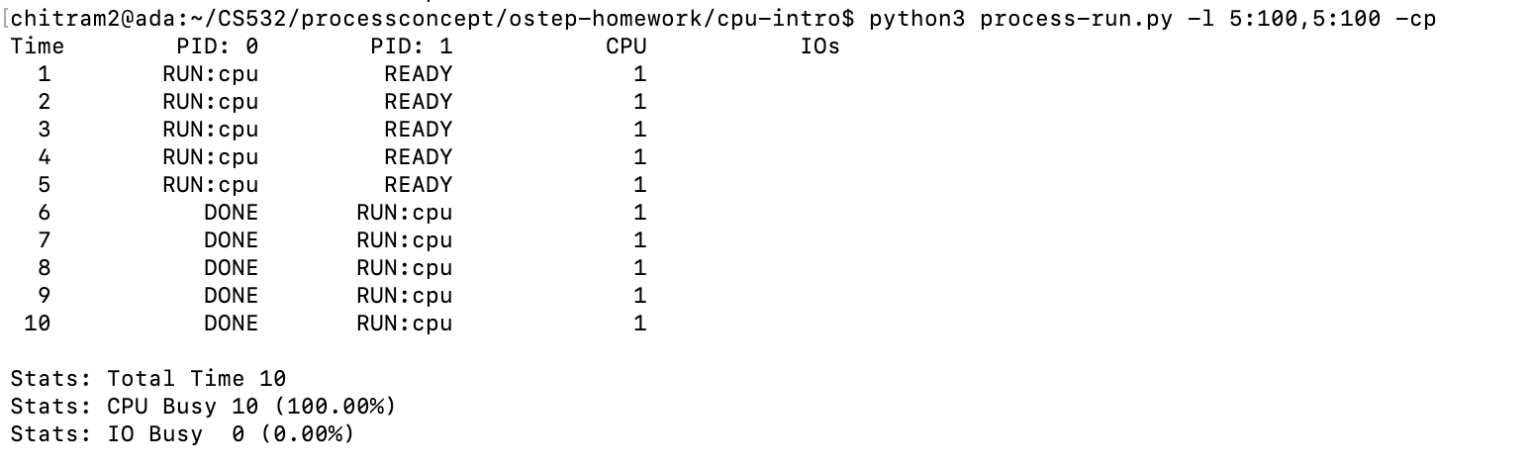
Complete Statistics for the processes using “-c” and “-p” tags

Slide 8
python3 process-run.py -l 5:100,5:100
CPU utilization would be 100% for both the processes
Process (PID:0) has 5 instructions and the CPU used is 100%
Also, Process (PID:1) has 5 instructions and the CPU used is 100%
There is no IO usage so the CPU is utilized by maximum.
Total time for these processes is 10 ticks.

Slide 9
2. Now run with these flags: ./process-run.py -l 4:100,1:0. These flags specify one process with 4 instructions (all to use the CPU), and one that simply issues an I/O and waits for it to be done.
How long does it take to complete both processes?

Slide 10
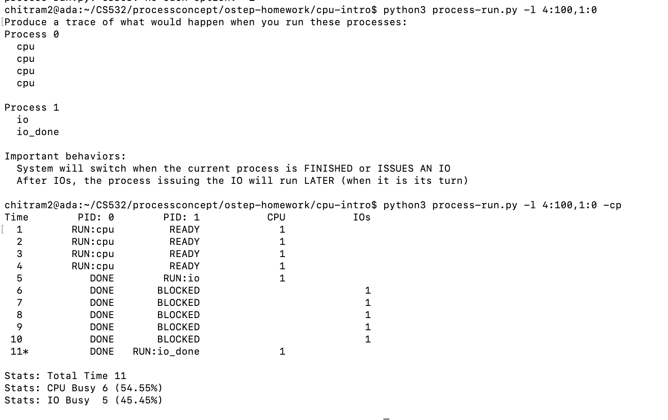

Slide 11
The time taken by the CPU to complete both the processes = 11 clock ticks
CPU was busy for 6 clock ticks (54.55%)
IO was busy for 5 clock ticks(45.45%).
Hence,
Total ticks = CPU busy Ticks + I/O Busy Ticks
Total Ticks = 5+6
Total Ticks = 11

Slide 12
3. Switch the order of the processes: -l 1:0,4:100.
What happens now?
Does switching the order matter?
Why?

Slide 13
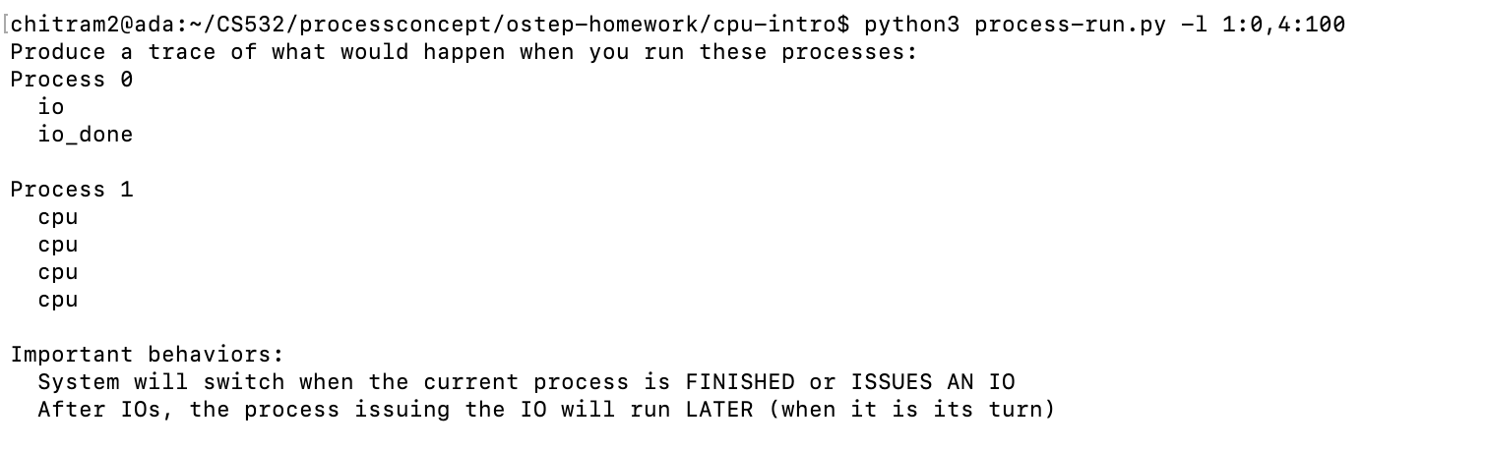

Slide 14
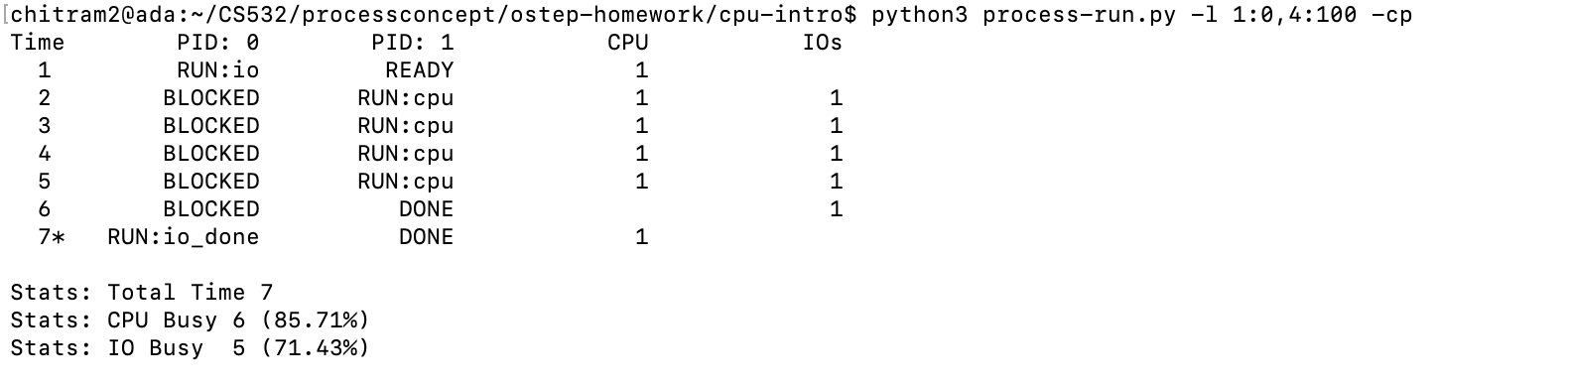

Slide 15
Yes, the switching order matters because the total time is reduced and the utilization of CPU and IO is higher than the previous question.
Total time is 7 ticks .The previous question total time was 11 ticks.
CPU busy was 6(85.71%). The previous question CPU was 54.55%.
IO busy was 5(71.43%) . The previous question IO was 45.45%.

Slide 16
4. We’ll now explore some of the other flags. One important flag is -S, which determines how the system reacts when a process issues an I/O. With the flag set to SWITCH_ON_END, the system will NOT switch to another process while one is doing I/O, instead waiting until the process is completely finished.
What happens when you run the following two processes (-l 1:0,4:100 -S SWITCH_ON_END), one doing I/O and the other doing CPU work?

Slide 17
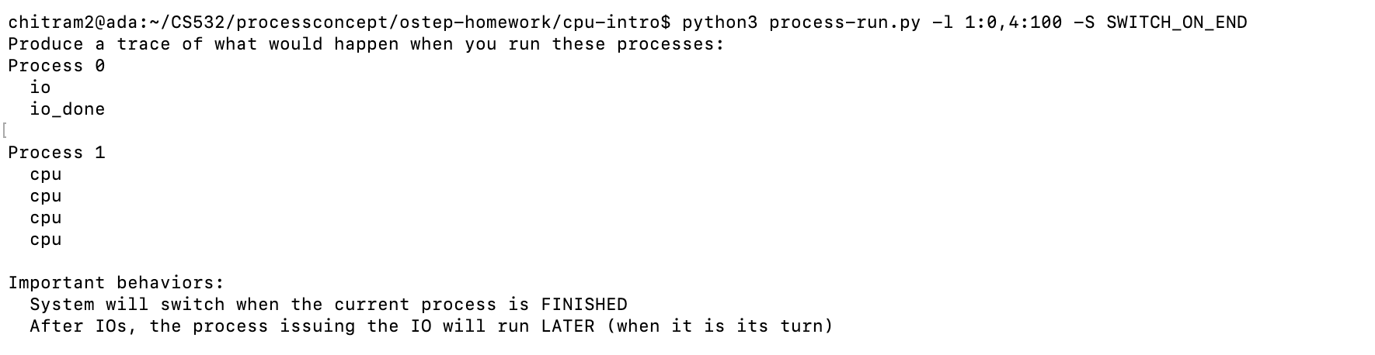

Slide 18
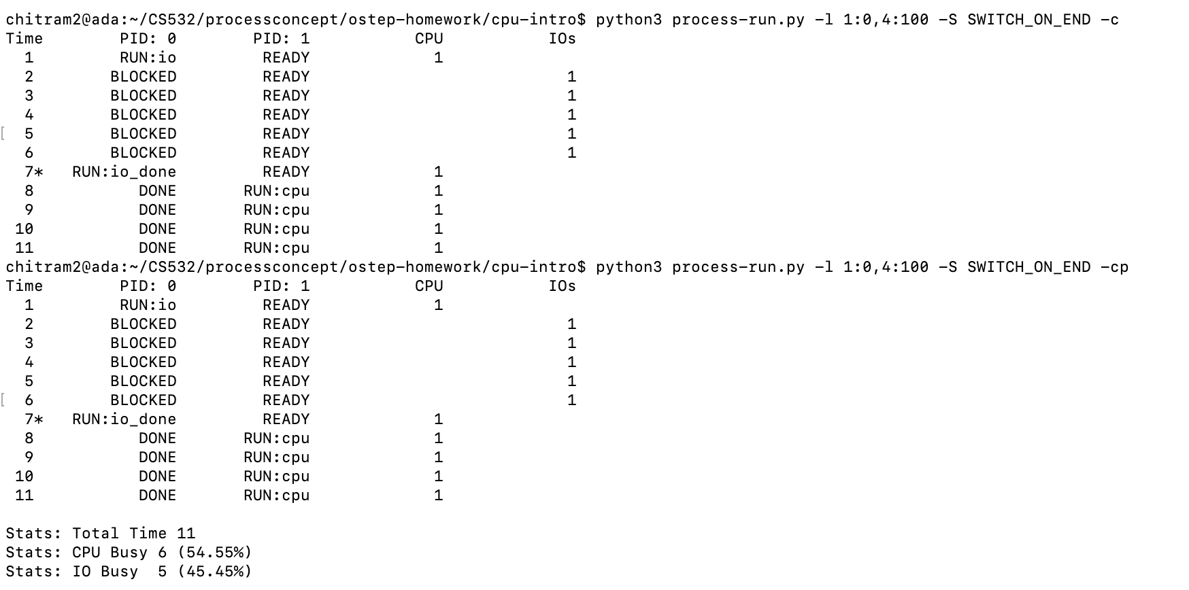

Slide 19
This command increases the total time and the utilization of CPU and IO is lower than the previous question (./process-run.py -l 1:0,4:100.).
Total time is 11 ticks .The previous question total time was 7 ticks.
CPU busy was 6(54.55%). The previous question CPU was 85.71%.
IO busy was 5(45.45%) . The previous question IO was 71.43%.
But the total time and the utilization of CPU and IO is similar to question 2 (./process-run.py -l 4:100,1:0.)

Slide 20
5. Now, run the same processes, but with the switching behavior set to switch to another process whenever one is WAITING for I/O
-l 1:0,4:100 -c -S SWITCH_ON_IO
What happens now?

Slide 21
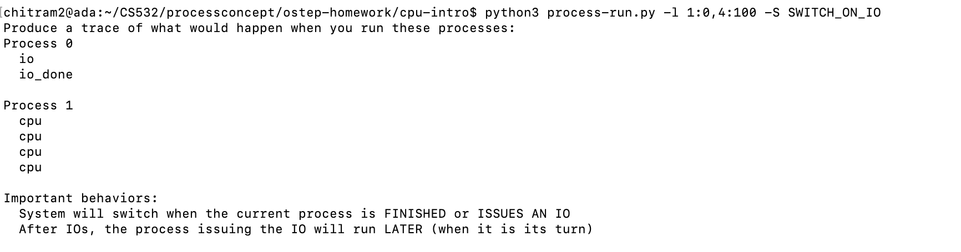

Slide 22
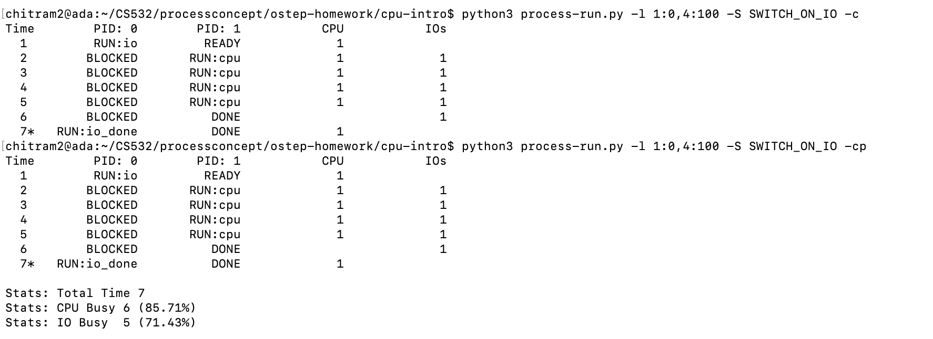

Slide 23
This command decreases the total time and the utilization of CPU and IO is higher than the previous question (./process-run.py -l 1:0,4:100 -S SWITCH_ON_END)
Total time is 7 ticks .The previous question total time was 11 ticks.
CPU busy was 6(85.71%). The previous question CPU was 54.55%.
IO busy was 5(71.43%) . The previous question IO was 45.45%.
But the total time and the utilization of CPU and IO is similar to question 3 (./process-run.py -l 1:0,4:100.)

Slide 24
6. One other important behavior is what to do when an I/O completes. With -I IO_RUN_LATER, when an I/O completes, the process that issued it is not necessarily run right away; rather, whatever was running at the time keeps running.
Try these parameters:
-l 3:0,5:100,5:100,5:100 -S SWITCH_ON_IO -I IO_RUN_LATER
Are system resources being effectively utilized?

Slide 25
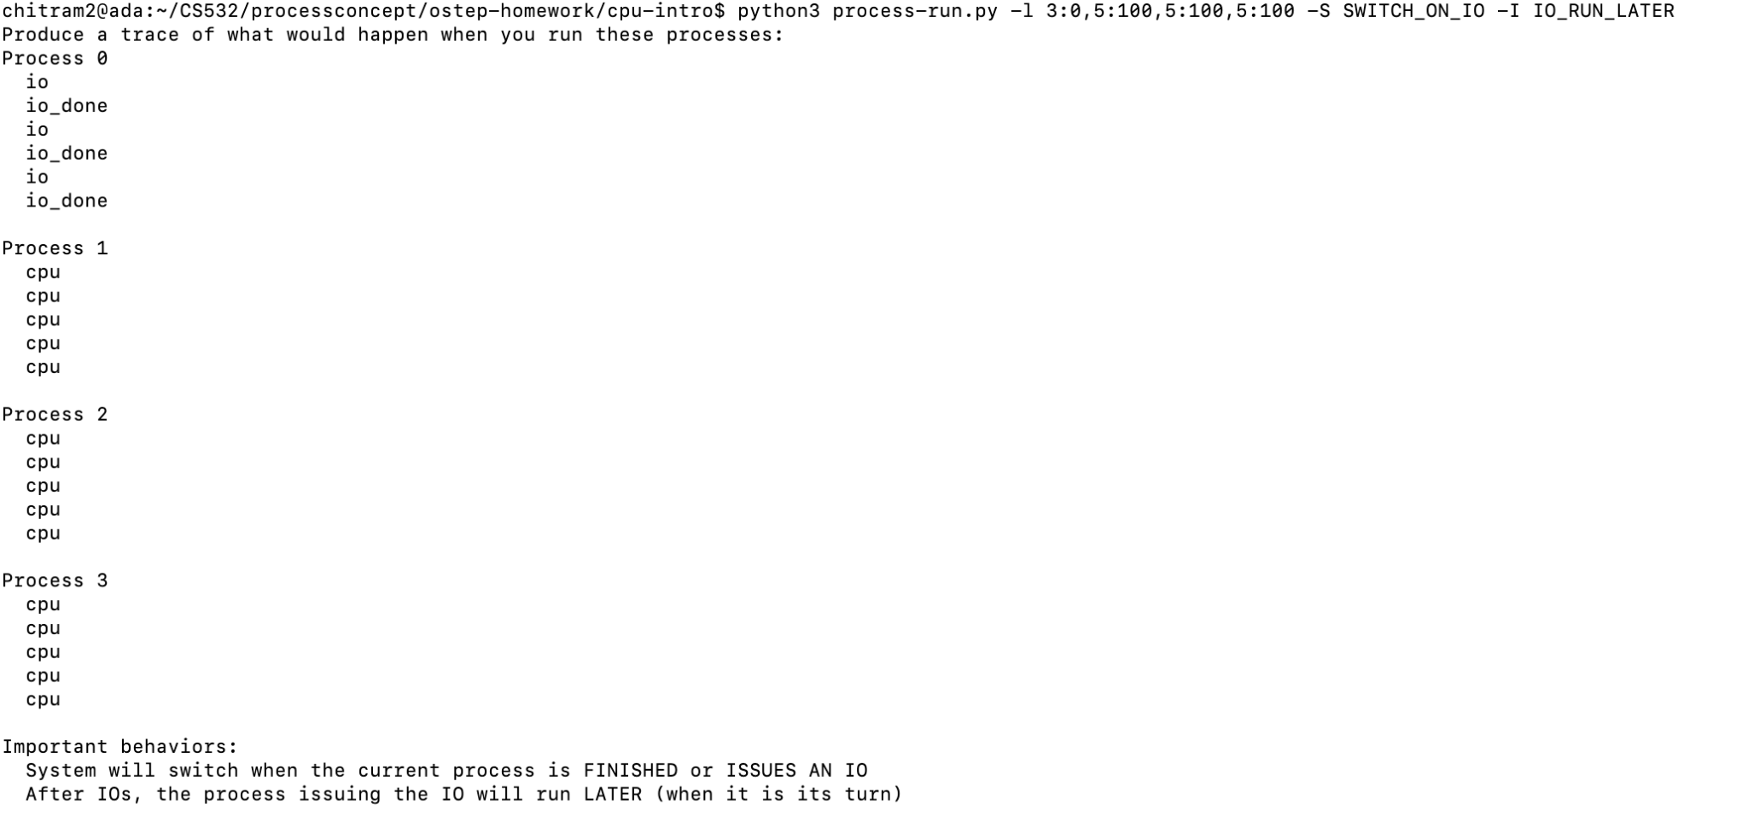

Slide 26
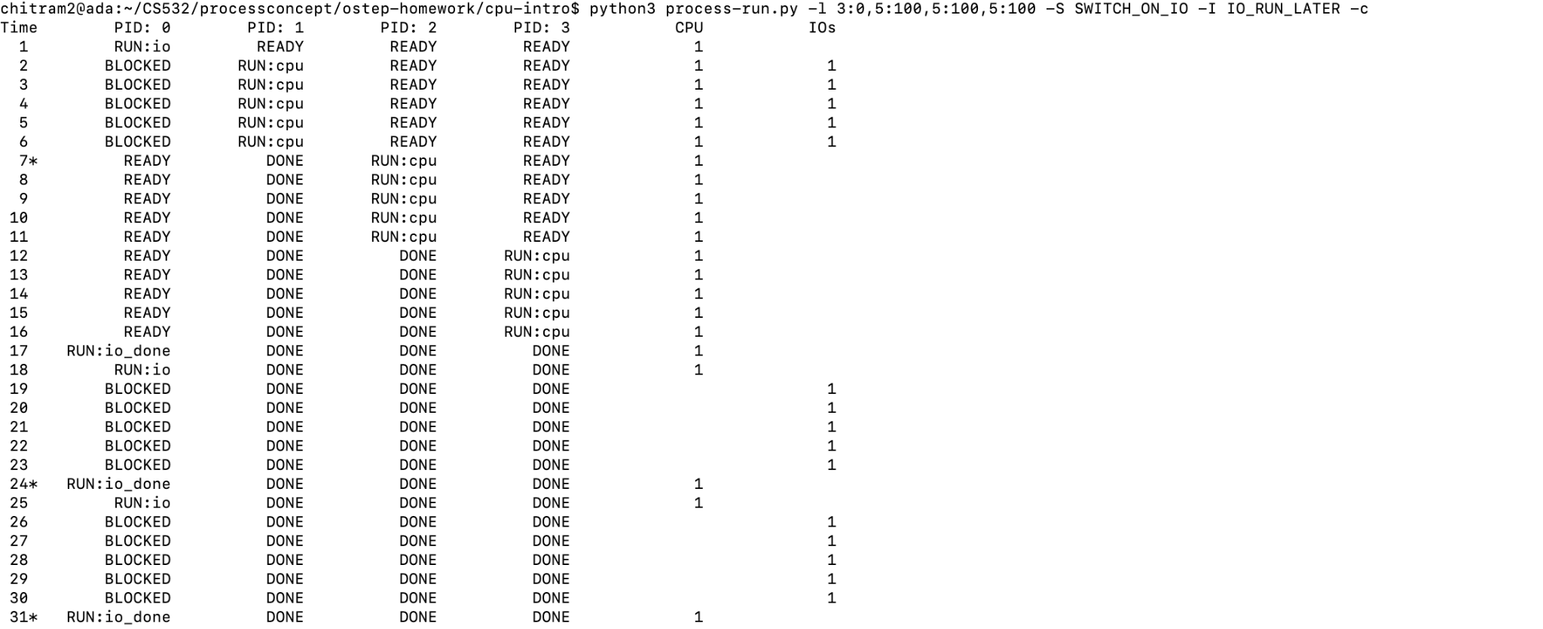

Slide 27
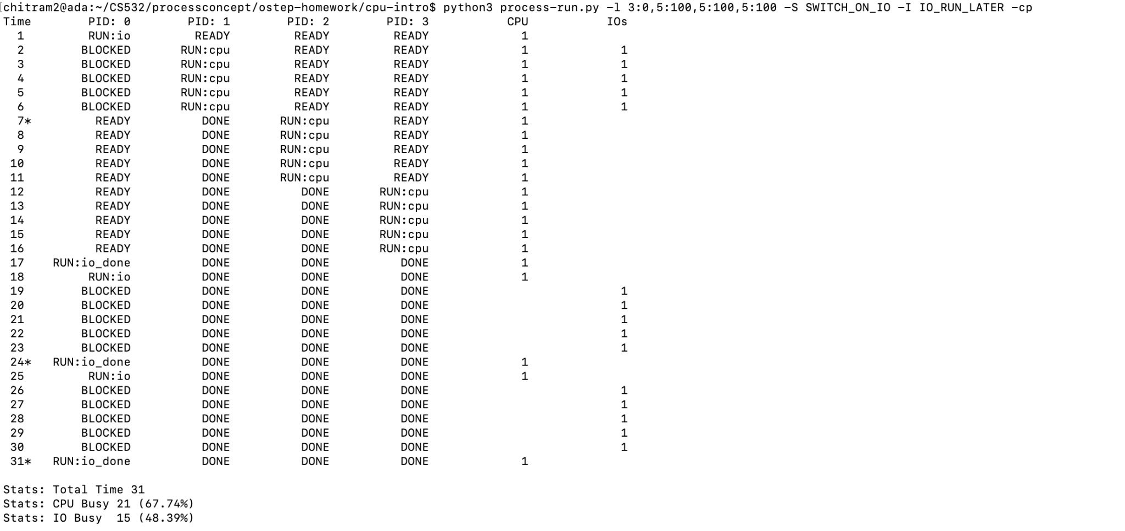

Slide 28
In this scenario there are 4 processes
When PID0 runs, the CPU goes to blocked state as it executes IO instructions. PID1 starts utilizing the CPU 100%. When PID1 finishes it goes to Done state and PID2 starts utilizing CPU 100%. When PID2 finishes PID3 utilizes CPU 100%
Only after the above the control returns to PID0 to execute Run IO_done
Then the second IO starts on PID0. During this time CPU goes to Blocked state for IO execution but there are no CPU instructions to execute.
Same with third IO instruction. CPU is idle
As per stats, the CPU utilization is 67% and IO utilization is 48% and total time is 31 ticks
Utilization for CPU and IO is low. There is lot of time when the PID1,2 and 3 are in DONE state and not being utilized.
IO is also in READY state for a long time but waiting for control to come back

Slide 29
7. Now run the same processes, but with -I IO_RUN_IMMEDIATE set, which immediately runs the process that issued the I/O.
How does this behavior differ?
Why might it be a good idea to immediately run a process that just completed an I/O?

Slide 30
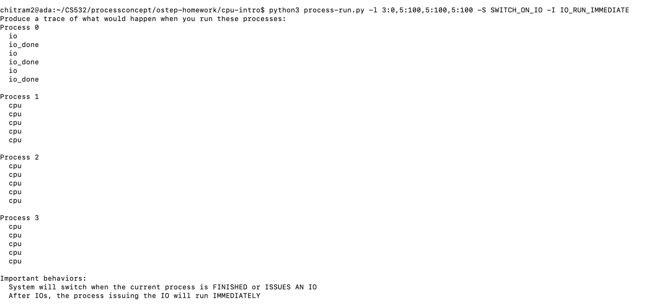

Slide 31
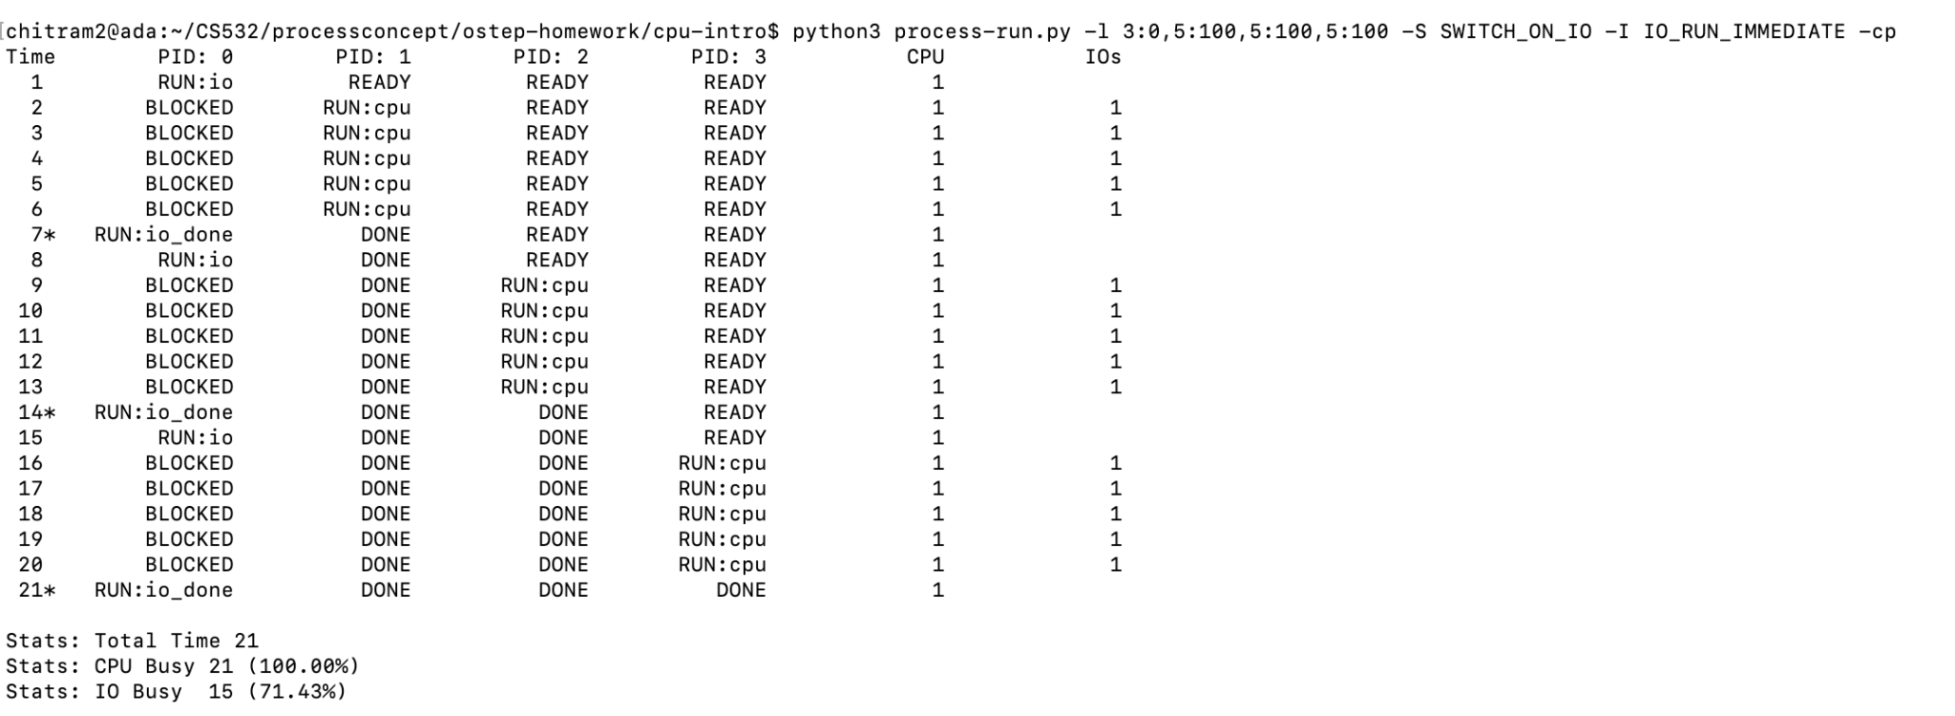

Slide 32
In this scenario also there are 4 processes
When PID0 runs, the CPU goes to blocked state as it executes IO instructions. PID1 starts utilizing the CPU 100%. When PID1 finishes it goes to Done state and returns control to PID0 to execute Run IO_done. Then PID0 runs the next set of IO instructions it goes to blocked state. Then PID2 starts executing CPU 100%.
Then the same as above happens. Once PID2 finishes control goes to PID0 to do Run IO_done. Then again PID0 starts next set of IO (goes to blocked state) and PID3 starts CPU 100%. And then returns control to PID0 for Run IO_done.
As per stats, the CPU utilization is 100% and IO utilization is 71.43% and total time is 21 ticks
Utilization for CPU and IO is very high compared to previous question. Total time is also reduced a lot (31 ticks to 21 ticks)

Slide 33
Difference between I/O_RUN_IMMEDIATE and I/O_RUN_LATER :
I/O_RUN_IMMEDIATE runs the process with I/O immediately it completes the execution of I/O . Hence it saves a lot of CPU time as well as increase the efficiency of CPU that is not for I/O_RUN_LATER.
It is better to immediately run a process that just completed an I/O because a process that perform one I/O often will perform another IO instructions soon. Also, the process is not waiting for long time READY and DONE state compared to previous question.

Slide 34
8. Try these randomly generated processes (and additional scenarios chosen by you):
-s 1 -l 3:50,3:50
-s 2 -l 3:50,3:50
-s 3 -l 3:50,3:50
Try each with -I IO_RUN_IMMEDIATE and -I IO_RUN_LATER
Try each with -S SWITCH_ON_IO and -S SWITCH_ON_END
No need to report anything for #8. Your goal is to develop intuition and understanding of why the system schedules processes in various scenarios.

Slide 35
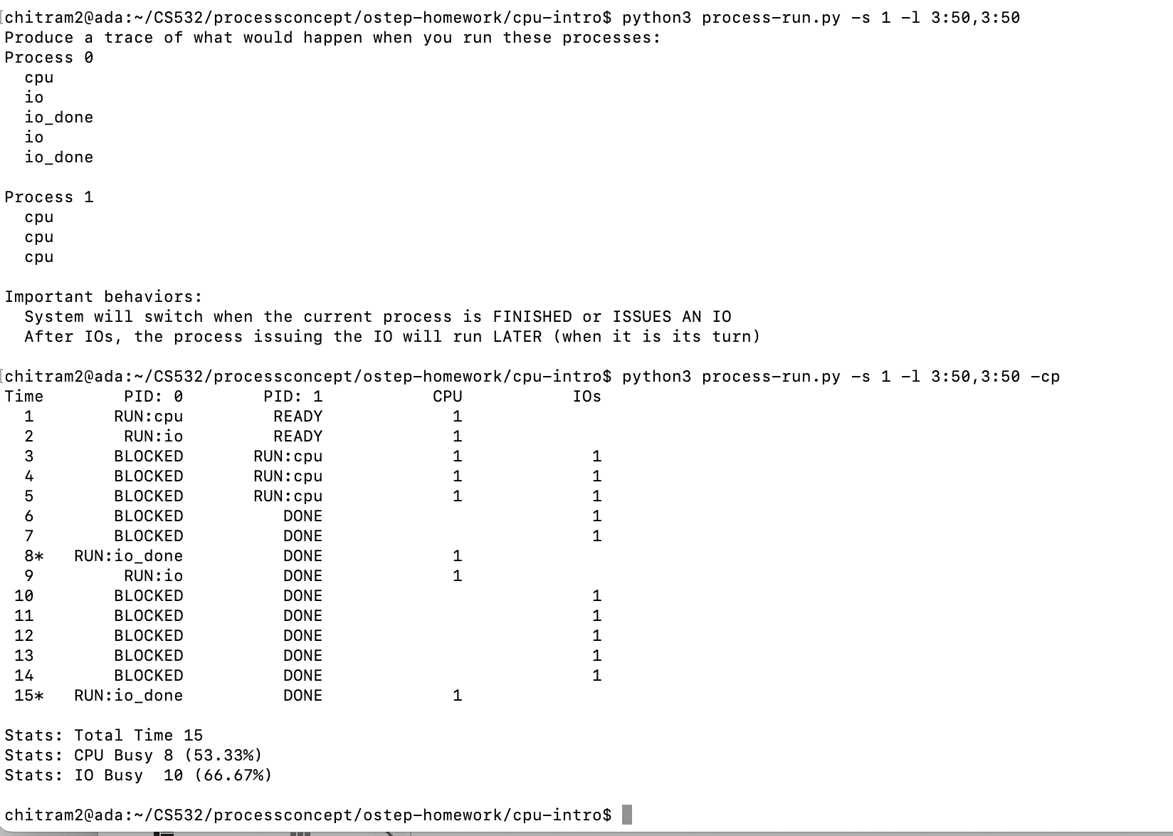
-s 1 -1 3:50,3:50

Slide 36
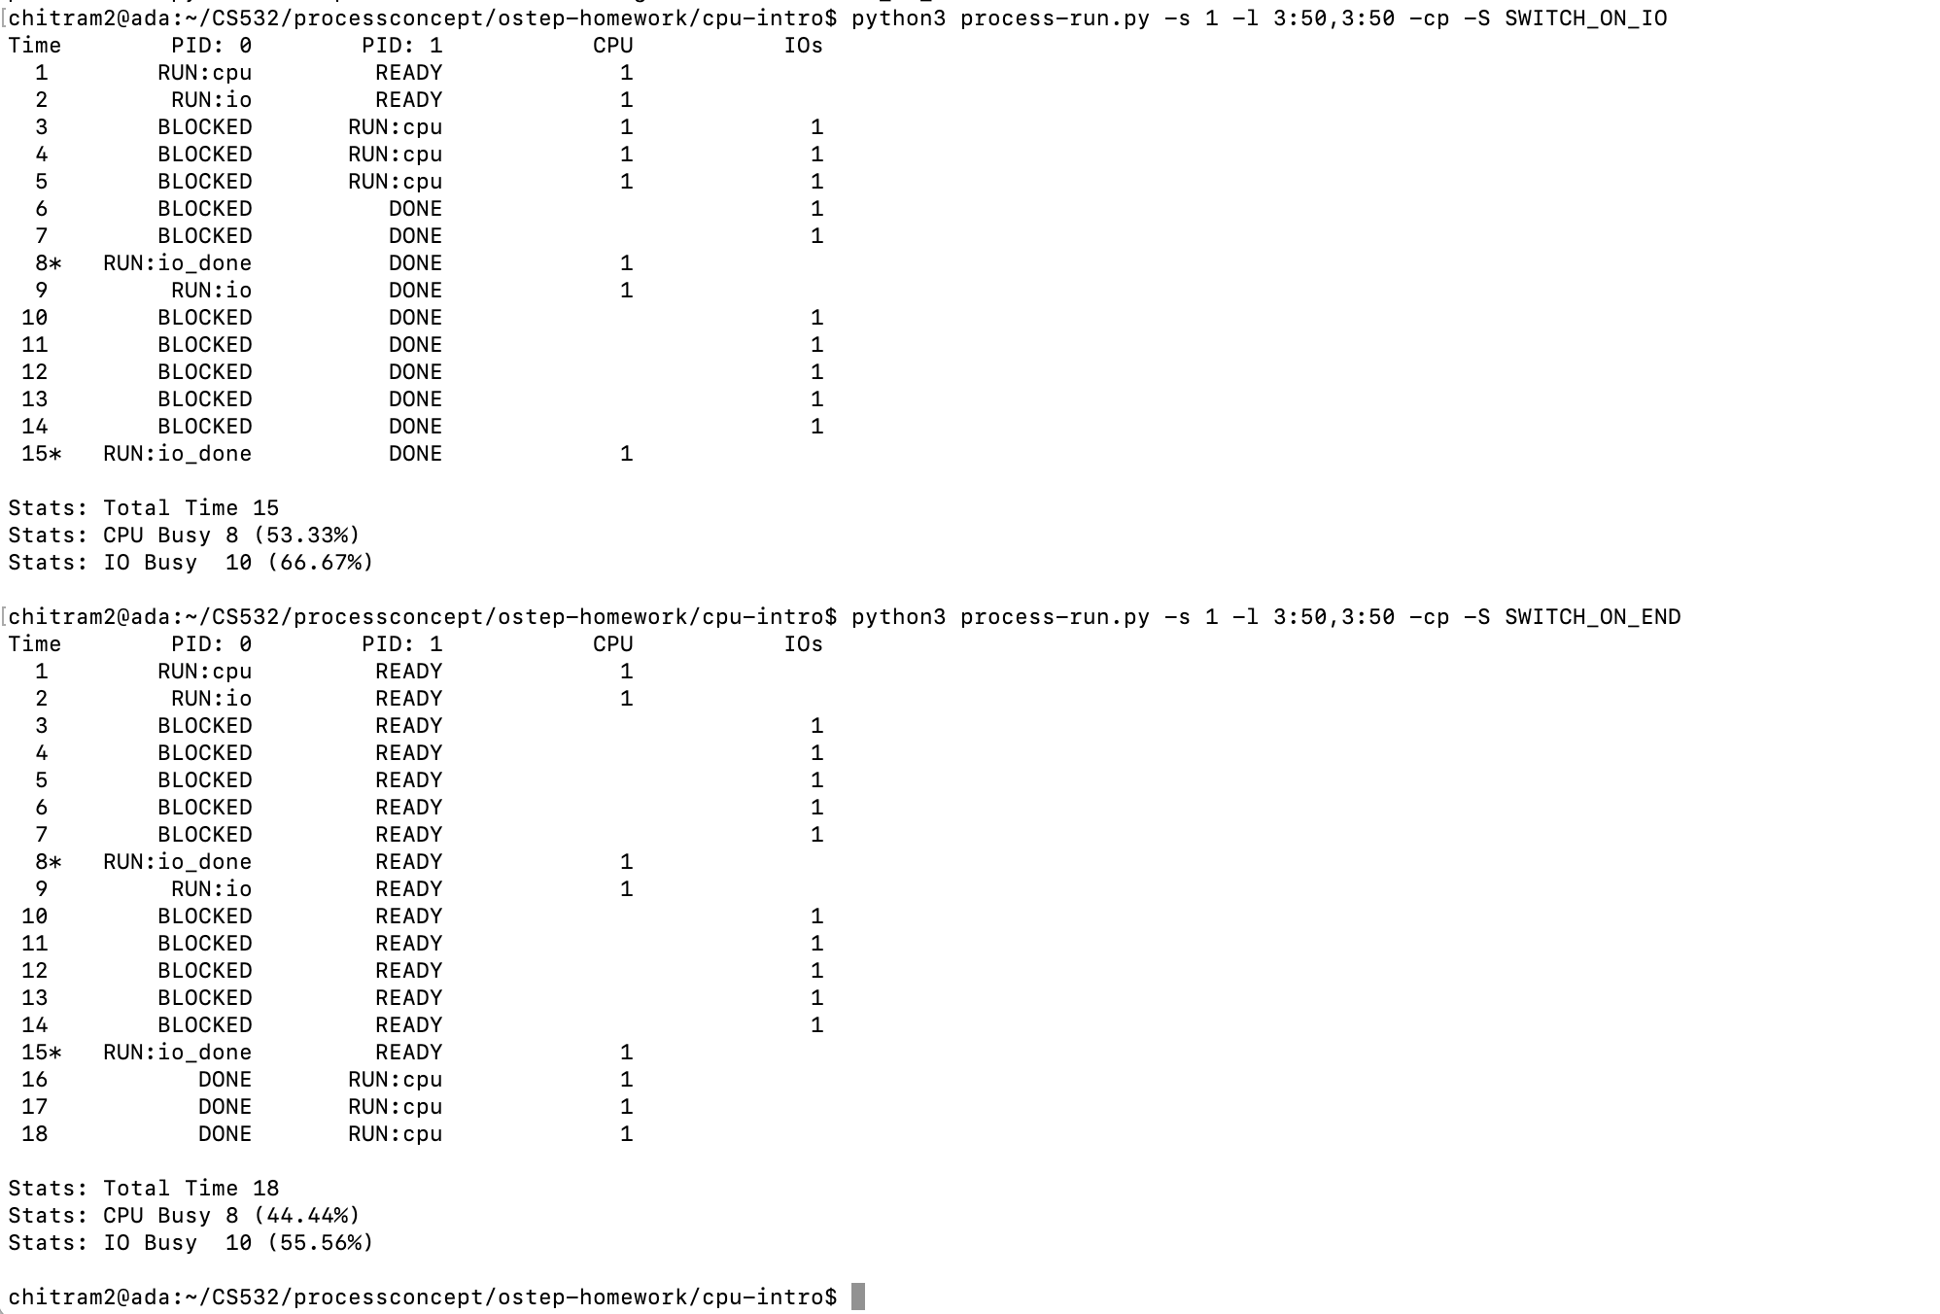

Slide 37
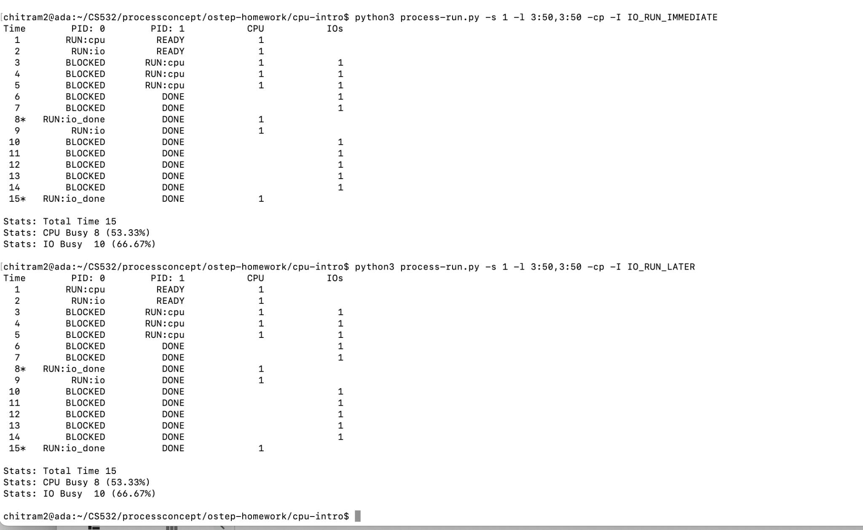

Slide 38
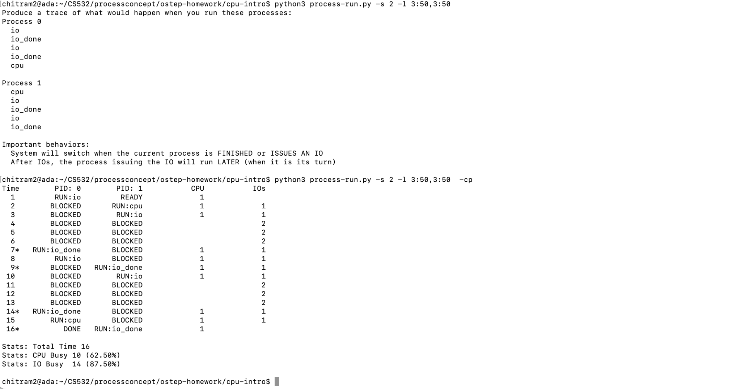
2) -S 2 -1 3:50,3:50

Slide 39
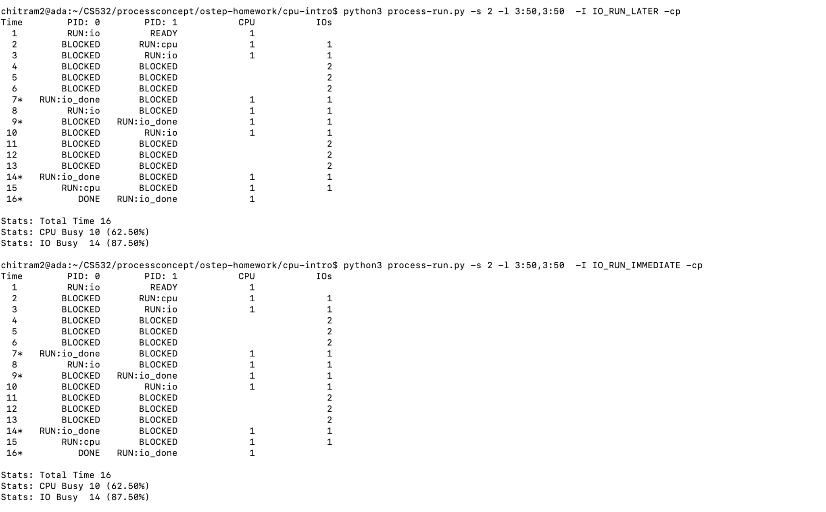

Slide 40
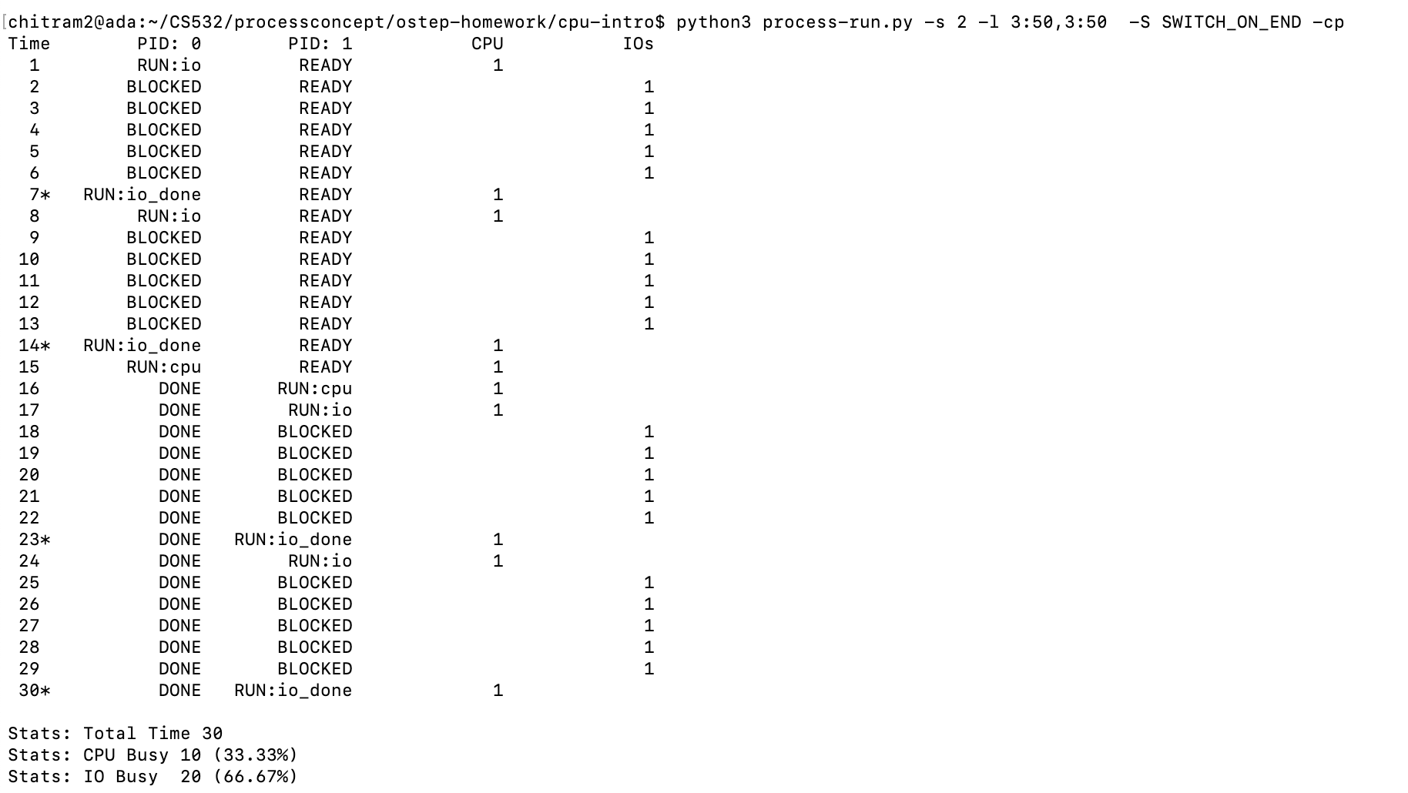

Slide 41
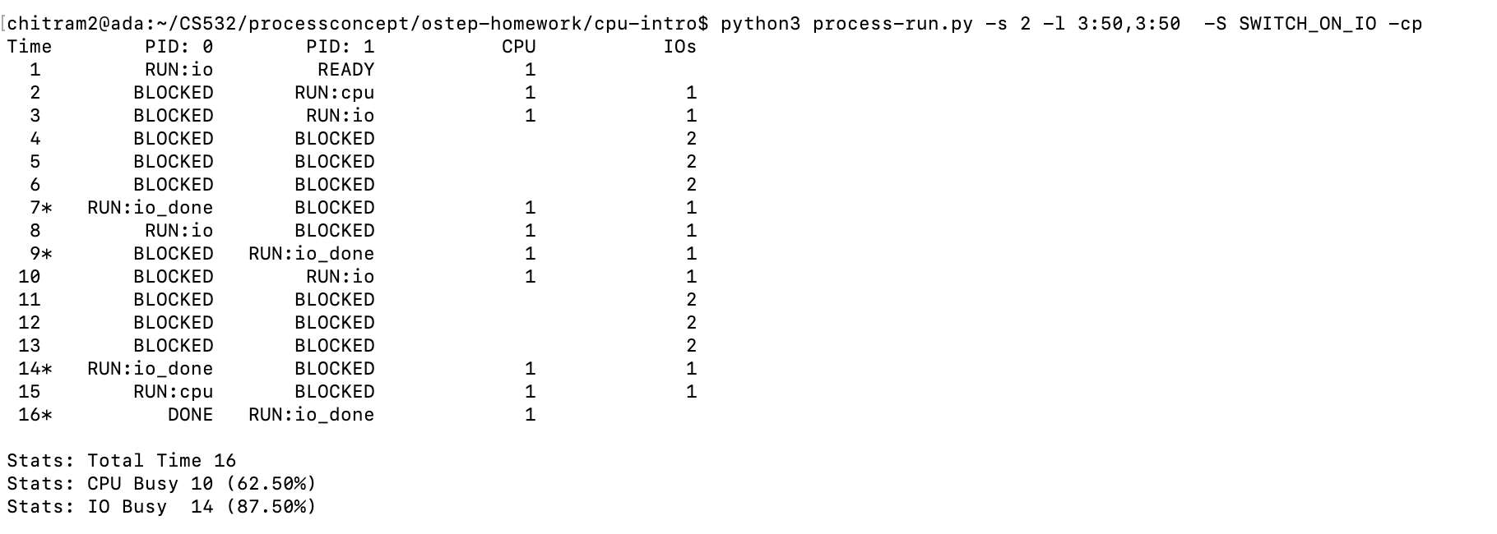

Slide 42
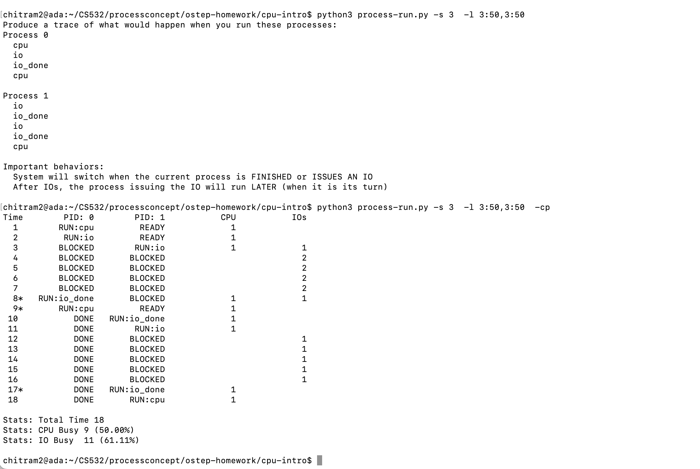
3) -s 3 -1 3:50,3:50

Slide 43
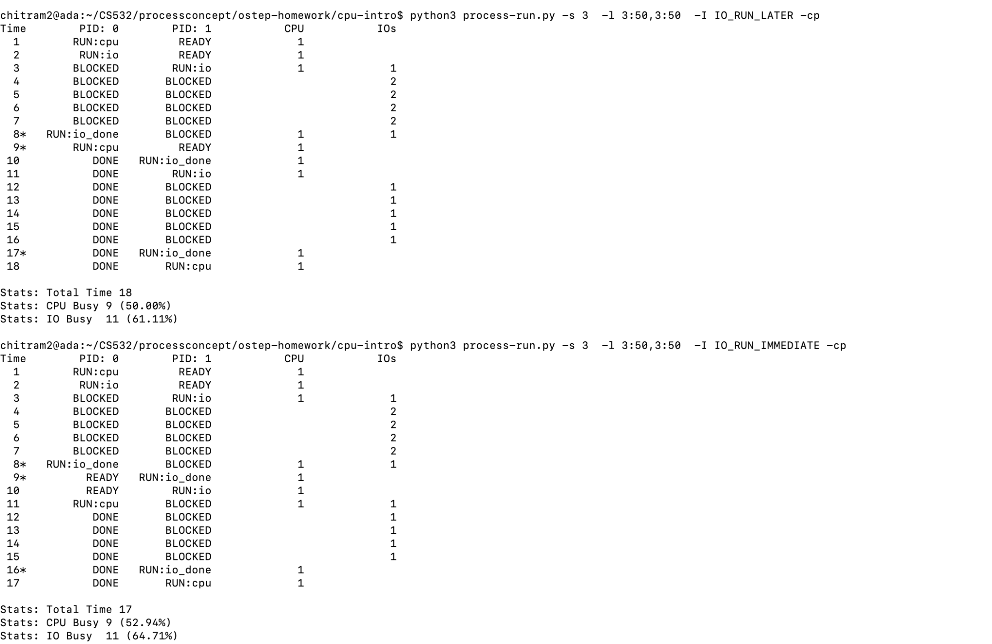

Slide 44
